Slide 1
Chapter 16

Slide 2
Objectives

Slide 3
Objectives (cont.)

Slide 4
Objectives (cont.)

Slide 5
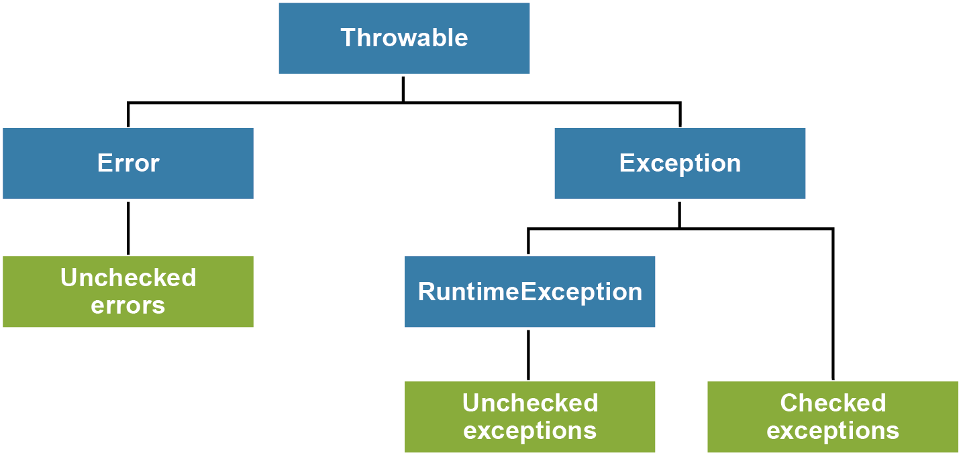
The Throwable hierarchy

Slide 6
Common checked exceptions

Slide 7
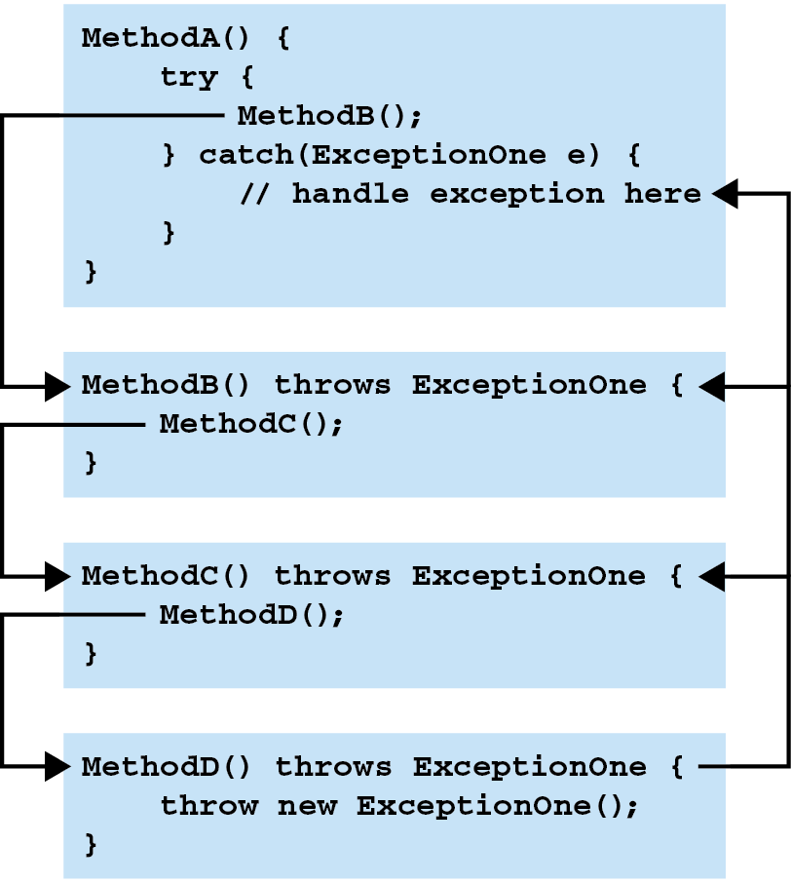
How Java propagates exceptions

Slide 8
Two ways to handle checked exceptions

Slide 9
The syntax of the try statement

Slide 10
A method that catches two types of exceptions and uses a finally clause

Slide 11
A method that catches two types of exceptions and uses a finally clause (cont.)

Slide 12
The syntax of the try-with-resources statement

Slide 13
A method that catches two types of exceptions and automatically closes the specified resource

Slide 14
Four methods available from all exceptions

Slide 15
How to print exception data to the error output stream

Slide 16
Resulting output for a FileNotFoundException

Slide 17
How to print exception data to the standard output stream

Slide 18
The syntax of the multi-catch block

Slide 19
A method that does not use a multi-catch block

Slide 20
A method that uses a multi-catch block

Slide 21
The syntax for declaring a method that throws exceptions

Slide 22
A method that throws two exceptions

Slide 23
The syntax of the throw statement

Slide 24
A method that throws an unchecked exception

Slide 25
Code that throws an IOException for testing purposes

Slide 26
Code that rethrows an exception

Slide 27
Code for the DAOException class

Slide 28
A method that throws the DAOException

Slide 29
Code that catches the DAOException

Slide 30
When to define your own exceptions

Slide 31
A constructor of the Throwable class for exception chaining

Slide 32
Code that throws a DAOException with chaining

Slide 33
An interface that uses a custom exception

Slide 34
A class that uses custom exceptions

Slide 35
A class that uses custom exceptions (cont.)

Slide 36
A class that uses custom exceptions (cont.)

Slide 37
A class that uses custom exceptions (cont.)

Slide 38
A class that uses custom exceptions (cont.)

Slide 39
A class that uses custom exceptions (cont.)

